Slide 1
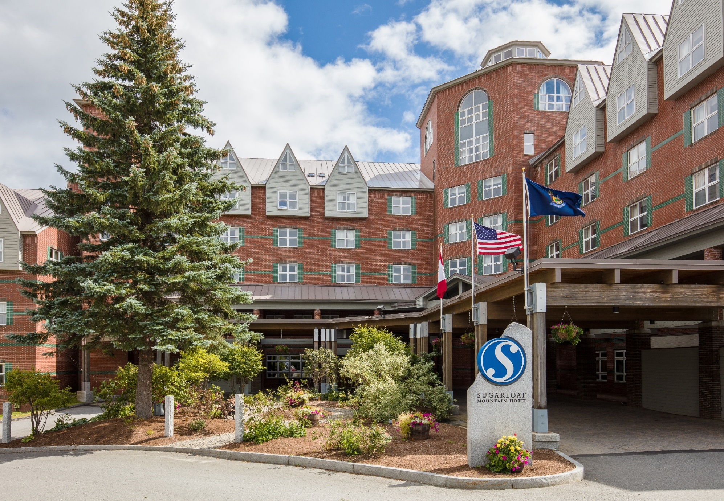

SM
SMCCA Annual Meeting
June 8, 2024

Slide 2

Call to Order & Introductions
Approvals and/or additions to the Agenda

Slide 3

SMCCA Board of Directors
Jim Bowers President
Karen Pelletier Vice President
Mary Berger Secretary
Stetson Everett Treasurer
Dana Clukey Board Member
David Ames Board Member
Jim Coppins Board Member

Slide 4
Agenda
1 Call to Order & Board Introductions Jim Bowers
2. Approval/Additions to Agenda Jim Bowers
3. Welcome and TEAMS Setup Scott Russell
4. Election Results and Secretary Motion Jim Bowers/ Mary Berger
5. Approval of Minutes from June 3rd , 2023 Jim Bowers
Business Arising from the Minutes
6 Year in Review Scott Russell
7. Budget Presentation Scott Russell / Stetson Everett
8. Capital Update Scott Russell
9. Renovation Progress Scott Russell / SMCCA Board
10. Revenue Management Zander Fogg
11. Resort Marketing Jessica Sechler – Director
12. Question and Answer Scott Russell / SMCCA Board
13. Adjournment/45North Social Jim Bowers

Slide 5
Welcome
TEAMS Setup

Slide 6
Welcome
Hybrid Meeting – Meeting OWL for online attendees
Meeting files are located in Dropbox link / In-person handouts
All TEAMS participants have been muted
Questions? At the end of each section
Please raise your TEAMS hand if you have a question – Brooklyn will monitor and control questions + unmute
Select the “Participants” option from the taskbar
Click the “Raise Hand” option at the bottom of the section
Wait for the host to give you the floor.
Or send a chat to Brooklyn – Make sure to click on Brooklyn only or will go to all attendees.
Before Speaking - Please state your NAME and UNIT before making a comment. It will really help with notes.
We will also have a Q&A at The End

Slide 7
Election Results

Slide 8



Election Results
476 Quarters / 299 Households
51 Total Voters
2 Positions / 2 Candidates
Running Unopposed
Voting Results – Total available points 10,000 per position
Jim Bowers 5983.0
Mary Berger 5983.0

Slide 9
Management
Dana Clukey – VP of Lodging and Prop. Support
Scott Russell - GM of Resort Lodging
Brooklyn LeClair – Owners Services Manager
Patrick Hayden – Hotel Maintenance Manager
Windy Boucher – Hotel Services Coordinator
Suk Spencer – Resort Housekeeping Manager
Letitita O’Connor – Hotel Housekeeping Supervisor
Zander Fogg – Revenue Manager
Jessica Sechler – Director of Marketing

Slide 10
The Year in Review
Our Amazing Team

Slide 11
An amazing year….
Good to Great:
Building on prior initiatives / success • Guest journey – Service
The Awesome Winter – A recap - Front Desk – Maintenance - Housekeeping
  14 H2B International in Lodging / Continued Relationship Harbor side / Game changer for Lodging
So very proud of the products and service we provide
Teamwork is simply amazing – Everyone helps wherever needed
Always working on raising the bar – How can we make it better
Building is in incredible shape for its age – Proactive not Reactive (Reserve Study)
1 Quarter on the Market / First in history / Future Listings
Forecasting a busy summer / winter business levels
Hotel will continue to be the premier property – No plans otherwise
Next year will be busy Renovation – Communication is key
Works in Progress:
Continued $$$ increases in Everything….
Summer Staffing (5 new Housekeeping) + Recruitment + Retention + Training

Slide 12
The Budget

Slide 13
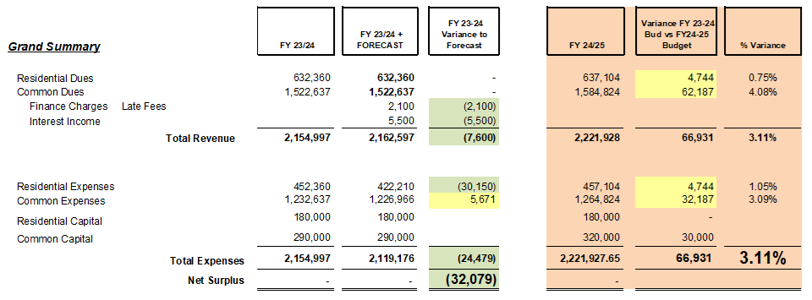




Budget Overview
Key Trends

Slide 14
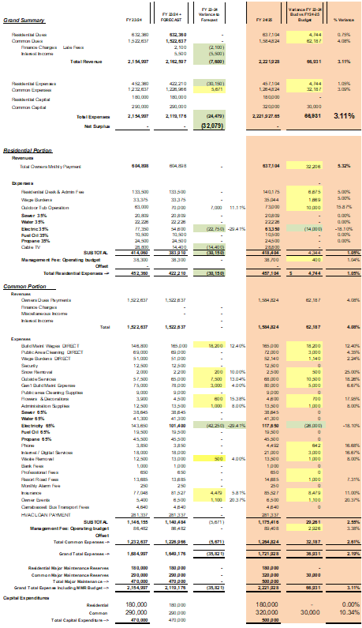
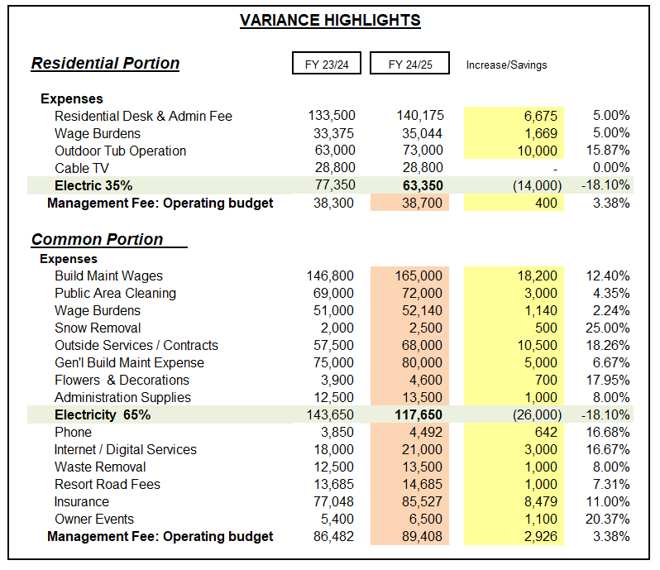
Budget Expense Highlights
SAVINGS
ELECTRIC
  Down from historic high -29%
  Forecasting conservative
    18% Savings from PY
CABLE
  Converted to Digital / Internet
  Locked in 3 Years / 9.2% Savings
  6 Month Promo -14k
  Relationship with Spectrum
INTEREST
  Income from CDs / Operating
  Exploring Sweep Accounts
INCREASES
WAGES
HOT TUB SUPPLIES
OUTSIDE SERVICES/CONTRACTS
GENERAL OPERATING
  Not under contract
1.71% INCREASE OPERATING
1.40% BUILDING RESERVES
TOTAL 3.11%

Slide 15
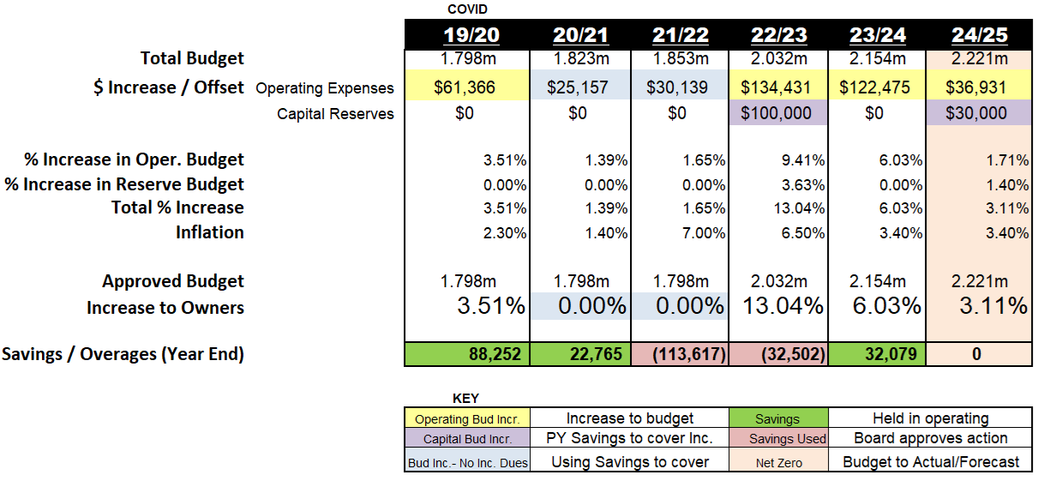
The Numbers
YOY Comparative

Slide 16
Capital Update

Slide 17
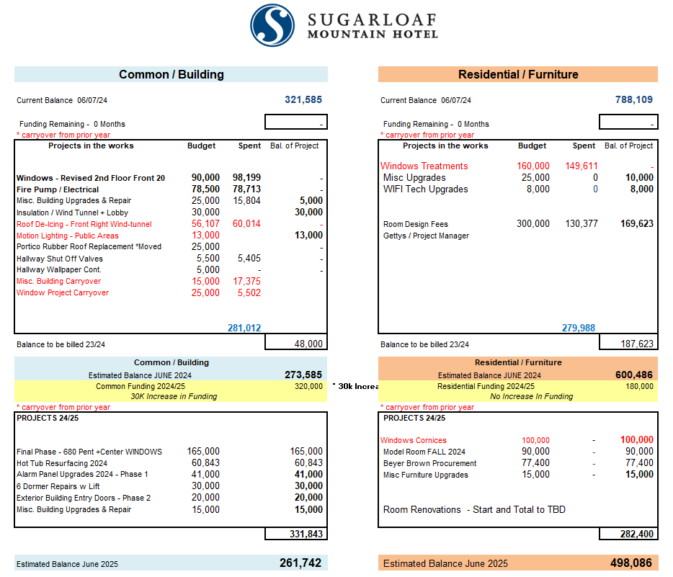
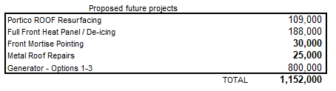
Capital
One page hand-out – Dynamic as the years/project flows
Criterion Brown - Reserve Study updated just last year
  Powerful tool – Our Guide
  30 Year Forecast with funding needs
  Building Breakout study to ensure cash-flow good with future reno.
Finding significant increases in prior year Project Quotes
  10-15% if not locked in with install dates
Common / Building - increase funding to $320,000
(30k Inc.) for this budget year.
Residential / Furniture – Keep funding at $180,000
Previously mentioned Reserve Funding increased 2023 $100,000 last year (50k/50k). First Reserve increase in seven years. TOTAL RESERVES $500,000 is 22.5% of the budget
Goal is to keep funds above $200k in case of emergency.

Slide 18
The Budget - Summary
2024/25
Recap of Budget Format – Current /Forecast/ Budget 24/25
Budget Year from July - June
Current Year Savings – Forecasted $32,079
  Everything is more expensive – Inflation at 3.4%
  Primary savings in Electric and Cable*
  Board allocated savings from Cash holdings for future
Total budget increases 24/25 3.11%
  Operating $36,931 1.71%
  Reserves / Building $30,000 1.40%
Planning for future projects along with known increases on Capital expenses 24/25
Budget increase 3.11%
Increase per Room Type
HALC $6.96
HQ / HQQ $7.95
H1S $13.20
H2S $18.59
HPENT $43.29
Housekeeping Fees
Avg. 4.5%
$1.00-$4.00

Slide 19
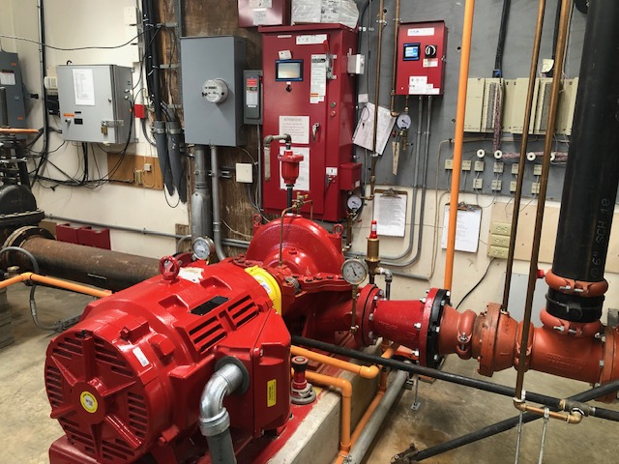
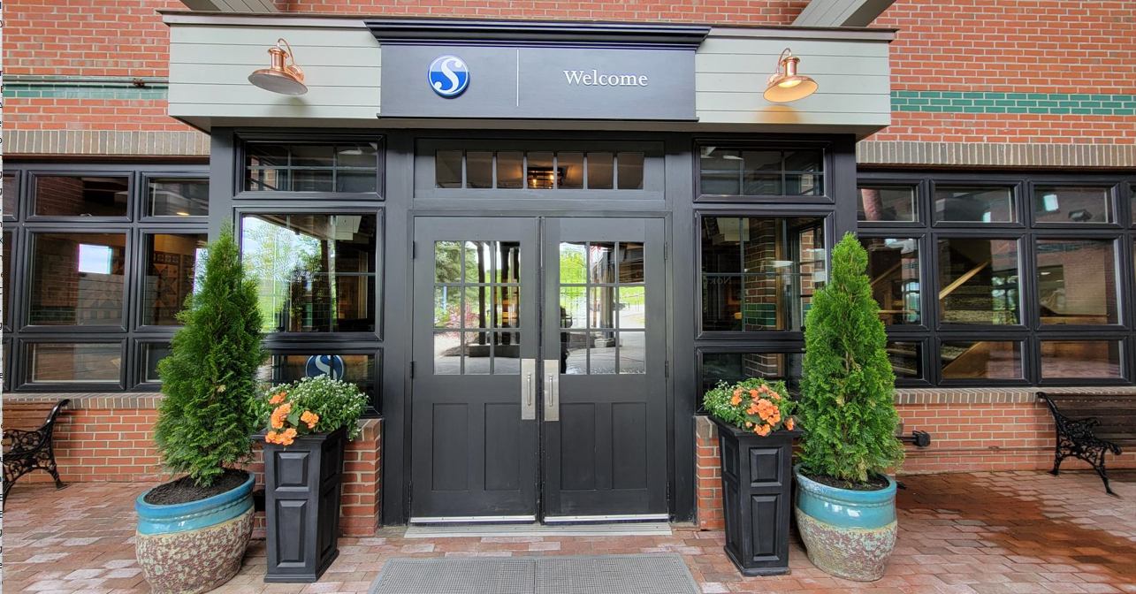

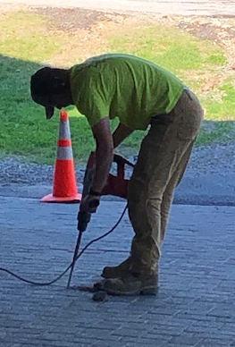
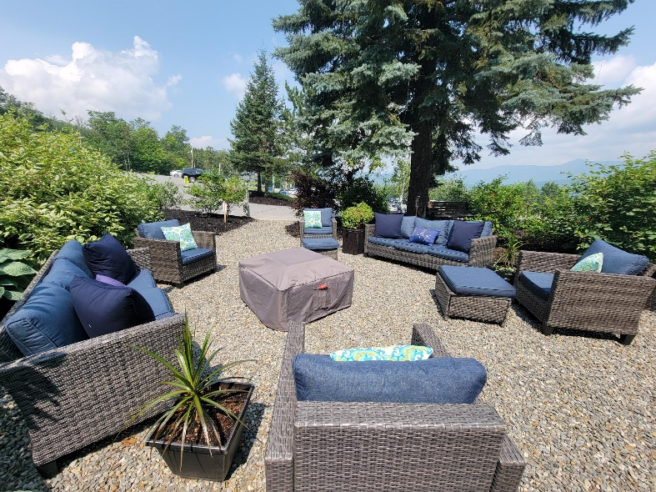
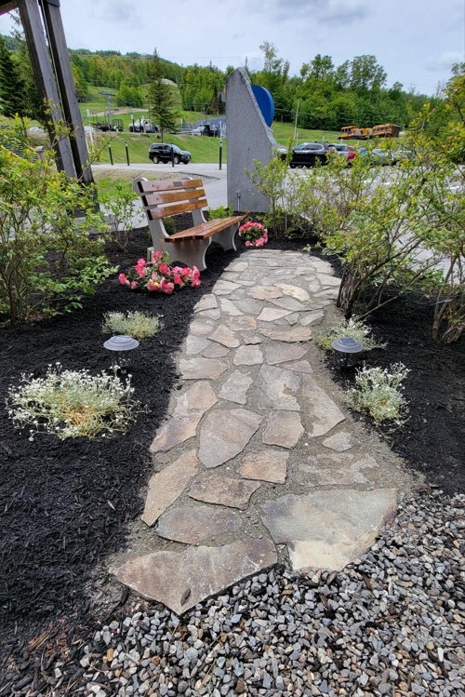
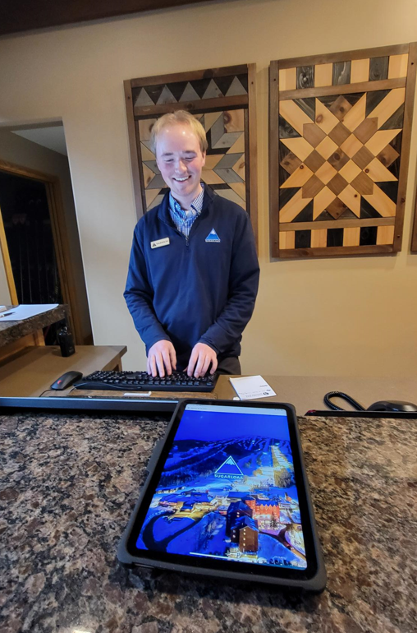
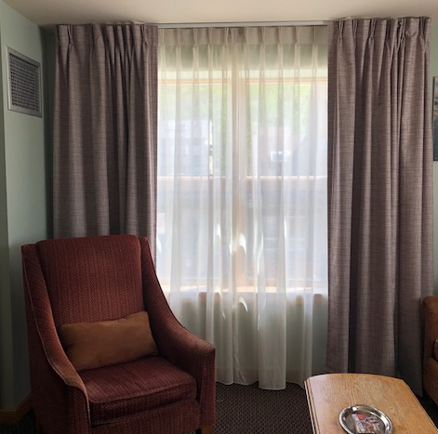
Capital Projects
2023/24

Slide 20
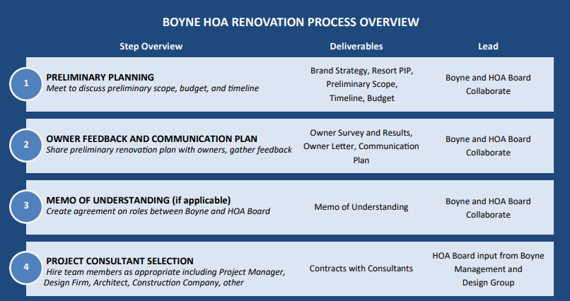
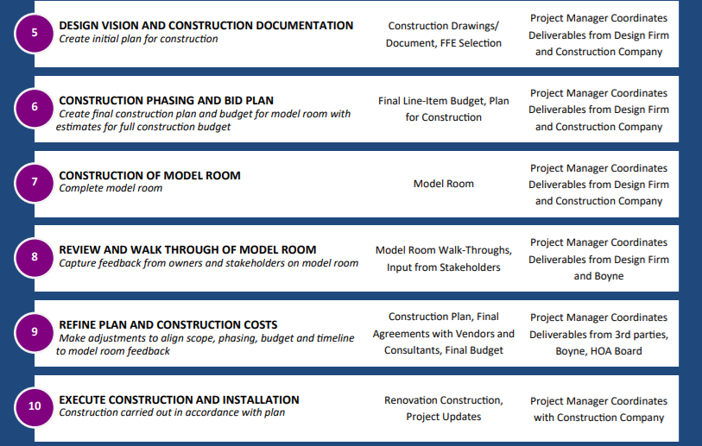

Renovation Process
&
Overview
SMCCA is here…

Slide 21
Timeline and Milestone Dates
Room Renovation - The Journey
Fall 2018 Initial planning - Puelle Design for Hotel/Rooms future vision / Modern Farmhouse
January 2020 Phased Room elements planned / Limited Scope / RFPs / Room furniture failing
May 2021 Common and Residential Reserve Studies Updated – Rand Engineering
April 2023 Owner Renovation Survey
June 2023 Annual Owners Meeting – 3 Designer Quotes / Survey results shared
July 2023 Jamie Spaulding - Lawyer review of Bylaws / Contracts / Specialized in Association Law
August 2023 Gettys Group chosen as Design Firm
September 2023 Hired Project Manager HEC+A Architecture and Design Company – Christine Kendall
September 2023 Renovation Project Team – 3 Days On-Site / Board Meetings / Walk-thrus
October 2023 Onsite Digital Room Scans / Critical for the design process
December 2023 Bi-Weekly Online Design meetings / Action Items / Follow-up
January 2024 Design layout review / Unique Layout 3D Mattiport Scans
February 2024 Beyer Brown selected as the Procurement Agent
May 2024 Landry/French Construction to serve as General Contractor / Walk-thru
June 2024 Annual Meeting update – Design Deck Handouts / Overview
Monthly Communications to Owners on Progress
September 2024 VOTE to owners for approval of funding
Bank funding to be secured – Options reviewed
Presentation for Homecoming / Updates
Fall 2024 Model Room construction starts
Discussion on model elements / Changes
April 2025 tentative phased construction by wing
Planning
Model Room and future construction

Slide 22




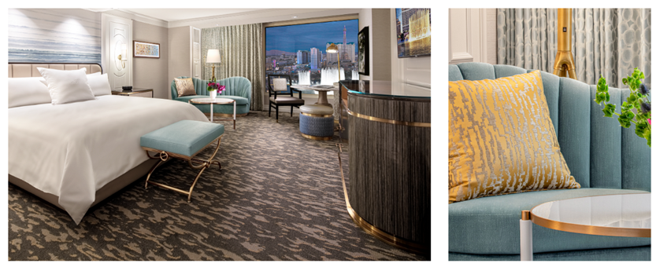


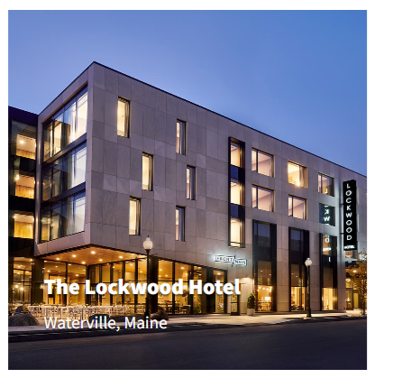



Room Renovation Project Team
Master Planning
Feasibility Studies
3D Massing Diagrams
Digital Model Renderings
Building Code Studies
Existing Conditions Surveys and Site Evaluations
Project Programming, Scheduling, and Budgeting
Town Planning Board and Zoning Approvals Assistance
Schematic and Design Development
Construction Documentation and Bidding
Construction Observation Services
Sustainable Design Services

Slide 23
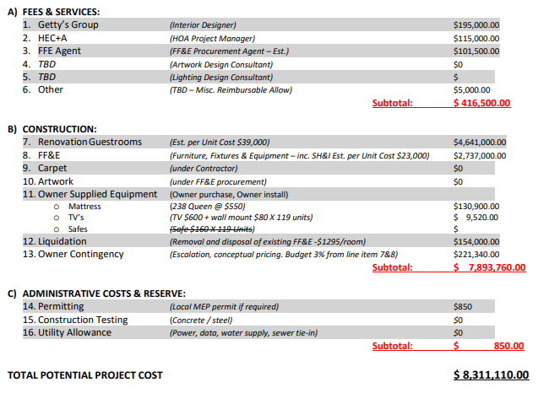
Renovation Process & Overview
Complex process to reach this point
Estimate based on prior projects of similar scale and finishes
Vote will be required to Move forward per Maine Condo Law
  1 Vote Per Quarter
  476 points
  Majority approval / 239
Board will review/approve method of funding
  Yearly thru Dues
  Reserves
  Partial Assessment / Combination / TBD

Slide 24

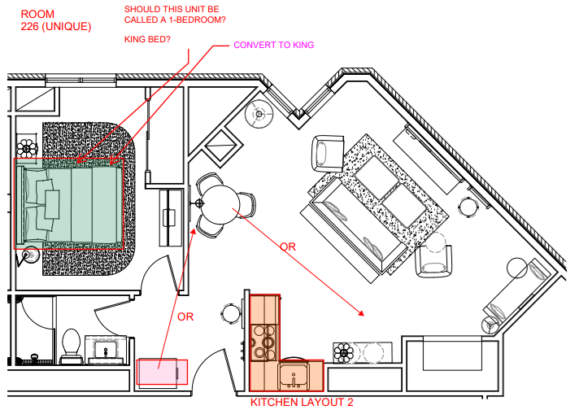
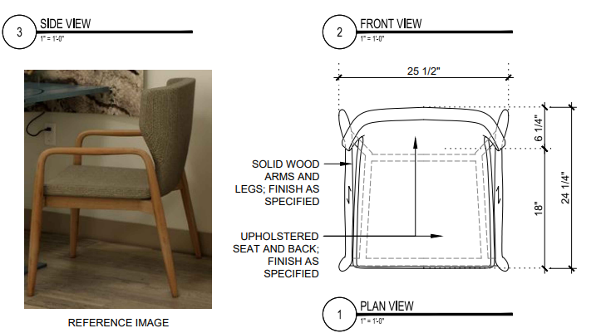
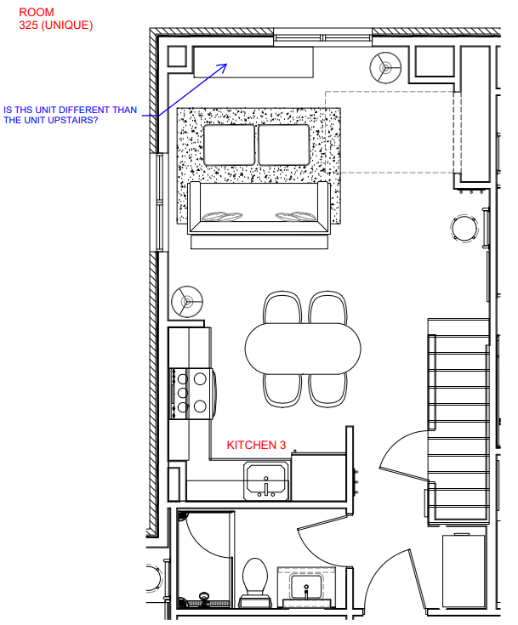
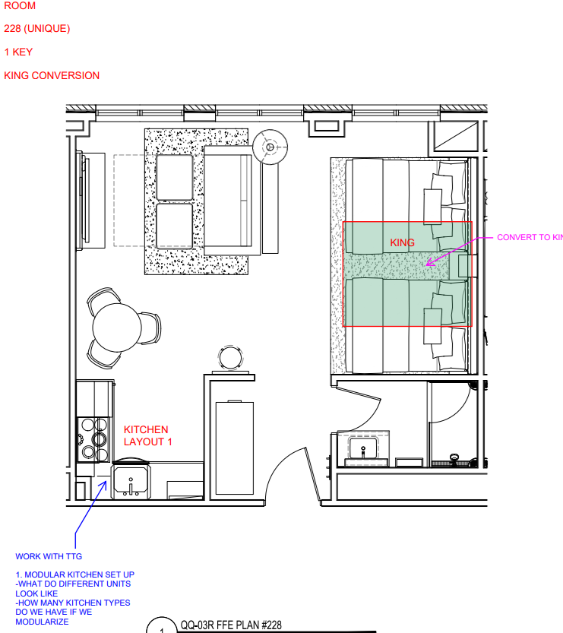
ROOM CONSIDERATIONS – DESIGN DECK
Process has been structured – now we understand
Boyne Design has been amazing – Thank you
Formal process was critical to forecast needs
  Room scans critical for furniture placement
  Element placement / Corners / Bump-out
Many rooms have too much furniture
  2 dressers in 1 rooms
  Some room are just cramped
Exploring Room configurations / best layout
Goal to replace Elements
  Kitchen features / Modular / Possible Upgrades
  Beds + Upgrades / Murphy bed vs. Queen
  Best utilization of Space
  Plenty of Storage / Under Bed / Media Unit
  Exploring Window Seat Removal / Extra space
  No one likes things taken away (me neither)
Queens to Kings – Exploring layouts with 32 Rooms
  Potential for increase revenues
  Increased requests / Only 1 in entire building
LVP Floor vs. Carpet / No Noise Transfer
Remodel allows for some fake walls to shorten / Open
Planning for Coffee Service/ Ice / Amenity Tray / Forward
Most bathtubs converted to showers
Notes:
3 POLES for people to approve the Motions.

Slide 25
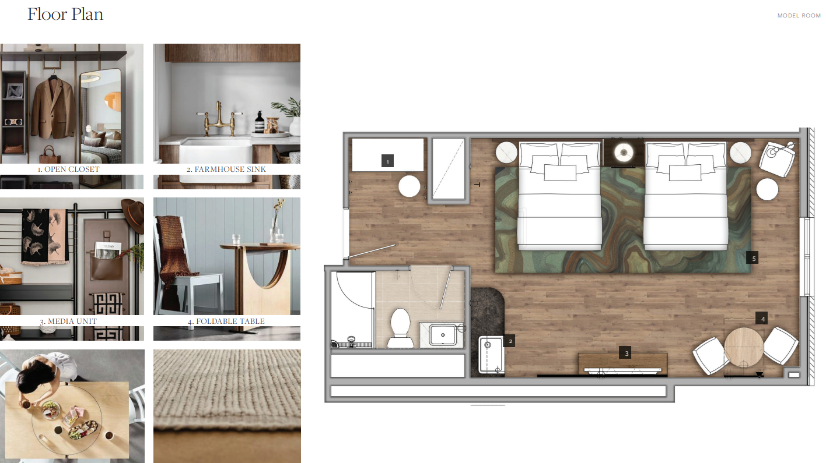
Model Room
Floor Plan & Elements

Slide 26
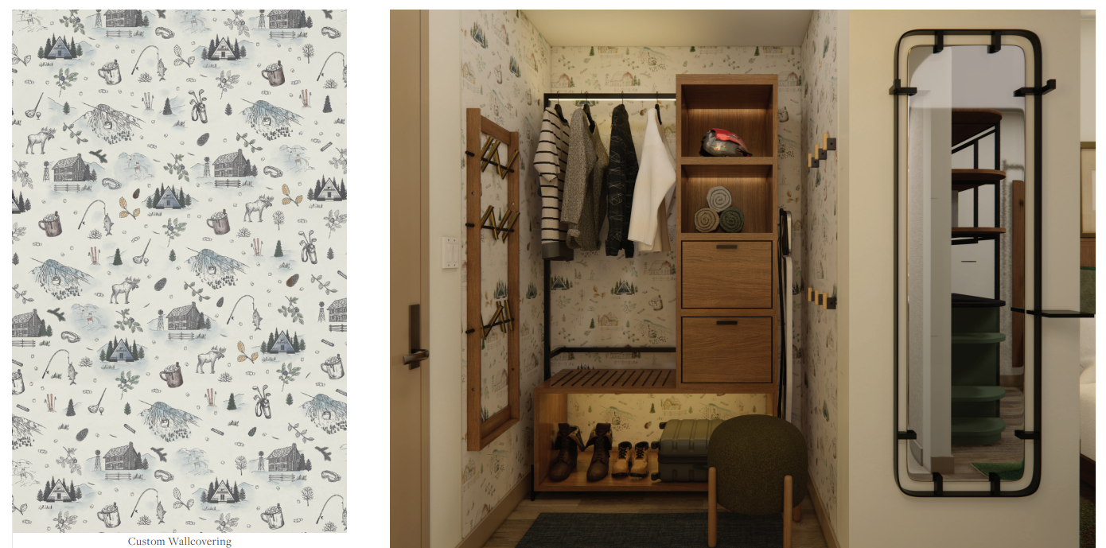
Model Room
Open Closet

Slide 27
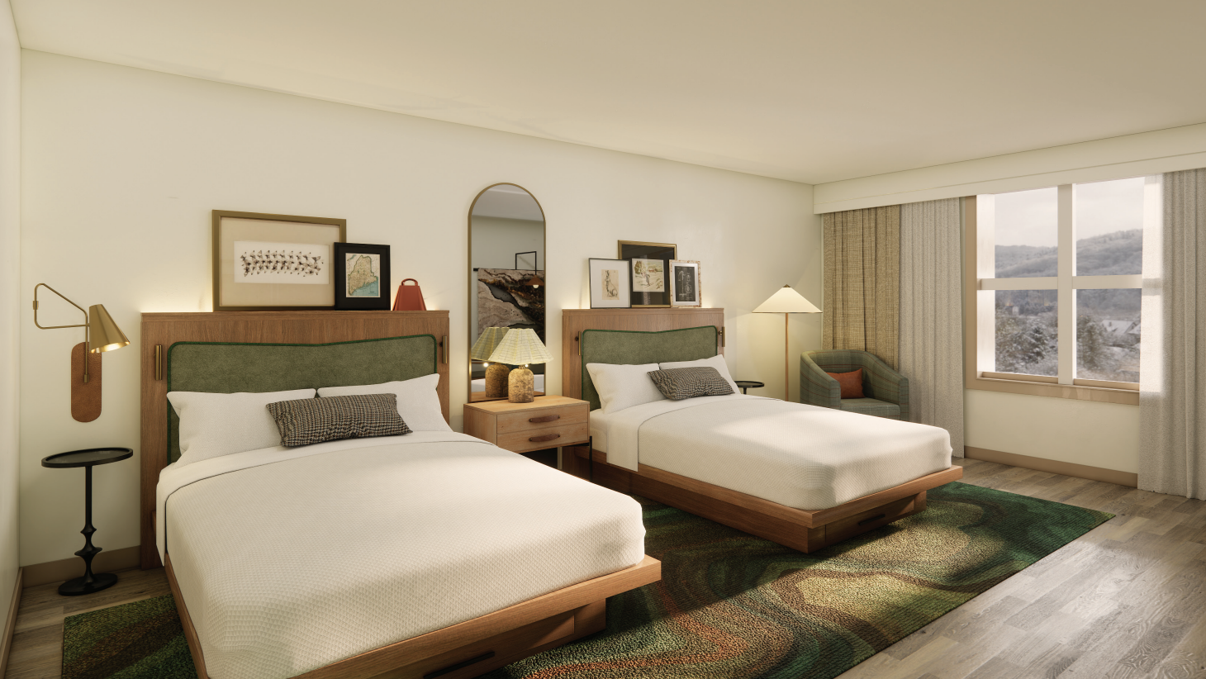
Model Room
Superior Two Kings

Slide 28
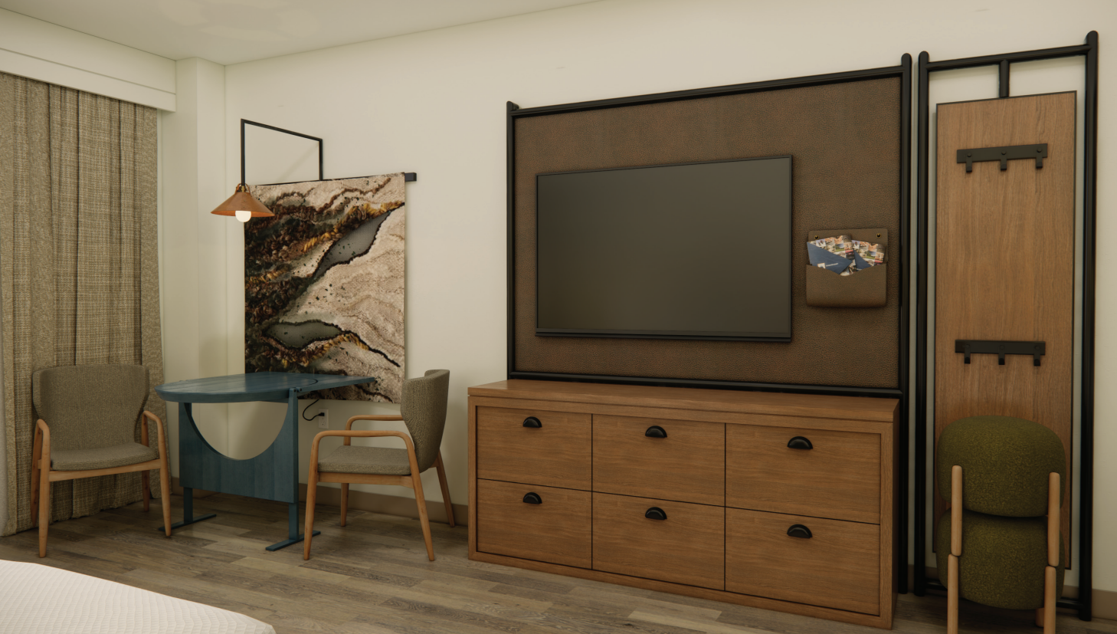
Model Room
Media Unit

Slide 29

Model Room
Room FF&E

Slide 30
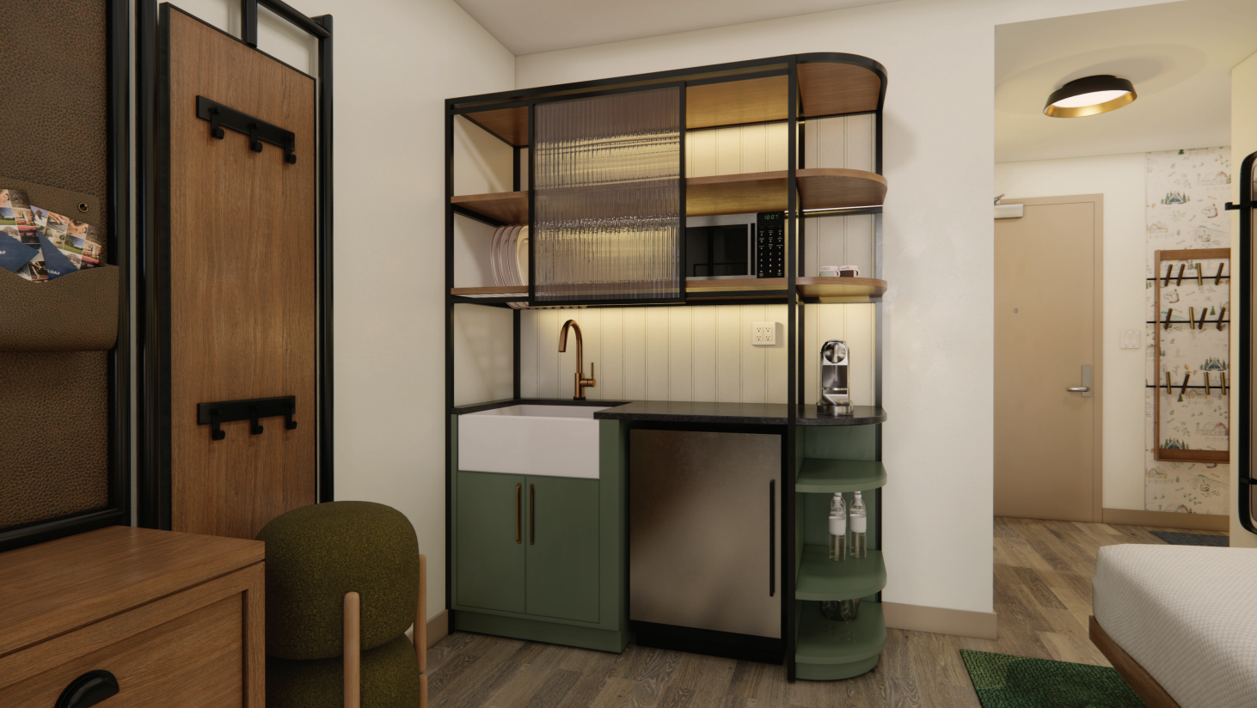
Model Room
Hotel Wet Bar

Slide 31

Model Room
Bathroom Features

Slide 32
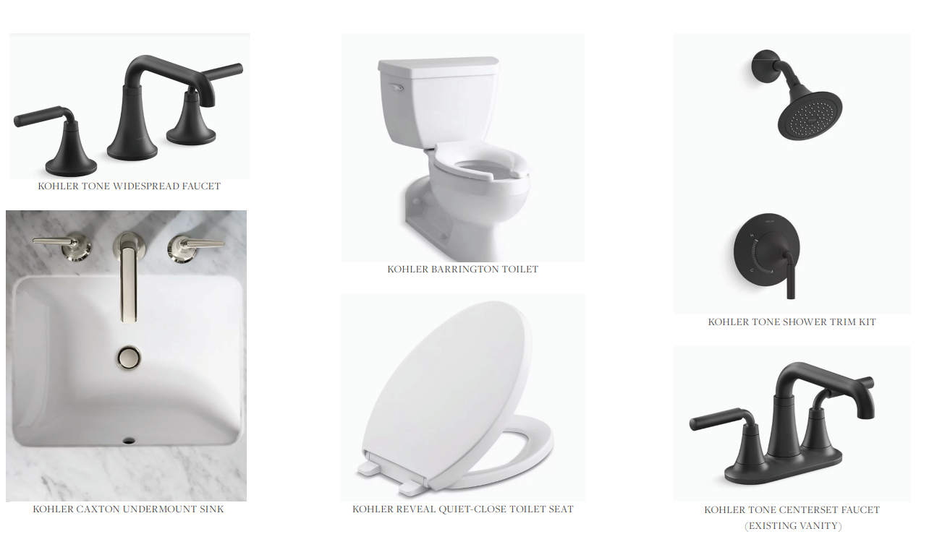
Model Room
Proposed Fixtures

Slide 33
Initiatives

Slide 34






Ongoing Green Initiatives
  Clean the World
    Amenity Bottle Recycle
    Soaps Recycle
  K-Cup Recycle
  All Room Recycling
  Bottle and Can Recycling
  Lobby Eco Products
  Office and Closet Auto Sensors
  Rechargeable Room Batteries
  Environmental Leader Designation

Slide 35
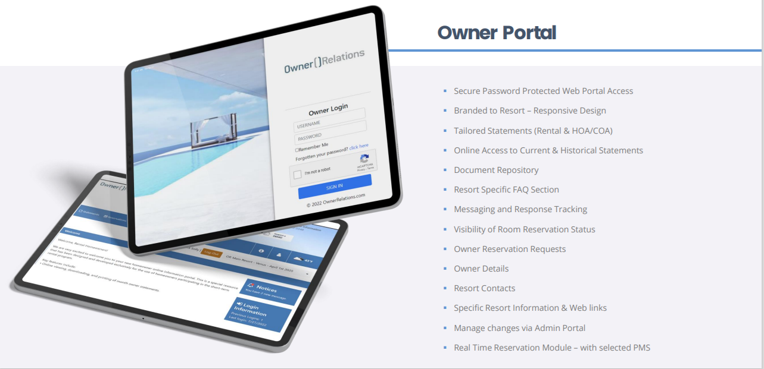
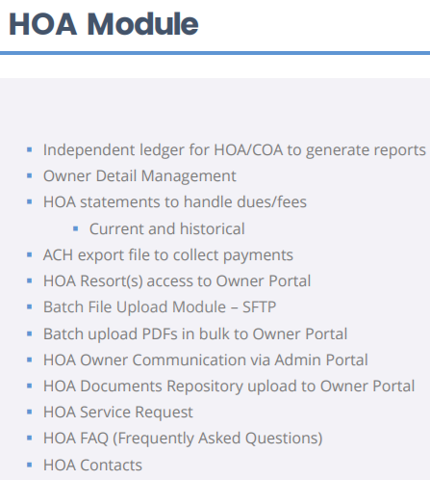
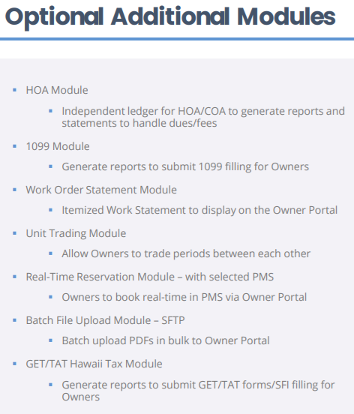
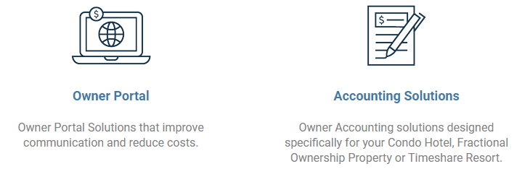
Updated Owner Portal

Slide 36
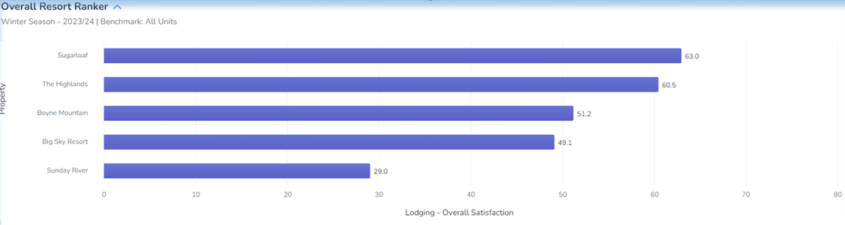
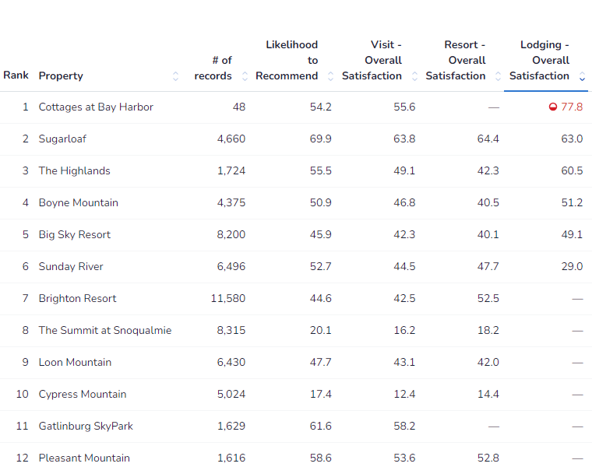
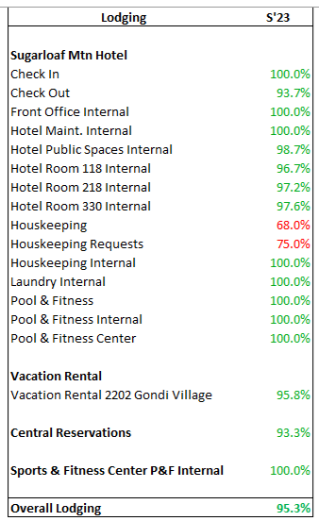
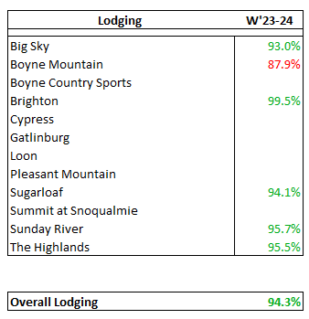
Service
Lodging Experience Overall Scores
Lots of hard work to hit the details…
Medallia Online Feedback Scores –
Great scores / Manager Responds to guests on all comments
  Winter Net Promotor 63%
  Leading all resorts for Winter
  Value for Price paid
BSA – Brand Standards Audit
Boyne audits 2 times per year.
All resorts had great scores…..
95.3 Summer
94.1 Winter
Always finding ways to improve guest interactions – Room ready notice Texts, Activity Communications, 45North Specials, etc.

Slide 37
Revenue Management
Zander Fogg

Slide 38

Revenue Management
Zander Fogg, Revenue Manager
Winter 23/24:
  FIT price sensitivity, dampened demand led to strategy adjustments
    Lowered some starting rates to ensure we didn’t come out overpriced
    Continued expanding our inventory available via 3rd party OTAs (Expedia, Booking.com)
    Upgraded/Oversold lower priced room types to maximize occupancy
    Group business remained steady and was a good base to go into the season with
  Saw lots of success with Events
    Allowed us some high-rate, high-occupancy weekends without relying on snow or weather
    Events calendar looking to expand for next season
    Solar Eclipse had a huge impact on the season, with sold out Sunday-Monday at Holiday Rates
Summer 2024
  Last Summer we began to see declining FIT demand, along with unfortunate weather
  Will focus on filling rooms using OTA’s and our new Golf promotion (Stay & Play)
  Marketing already pushing a few different promotions to push Summer business
  Group really strong this Summer, with high conversion rates
Winter 24/25:
  Open and available for early bookers!

Slide 39
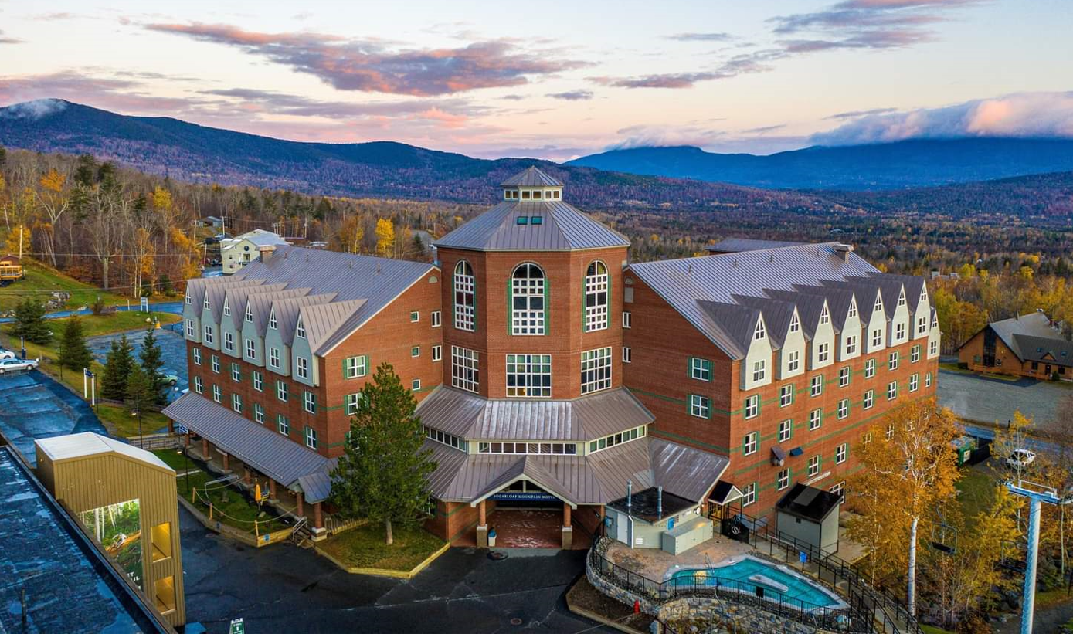
Lodging Stats
Zander Fogg, Revenue Manager
Guests increasingly want the Hotel Experience and continued focus on Rooms, Service and Amenities.
Revenue Manager Role and software investments continue proving results – Maxed out Daily Rates
Lodging had a great financial winter – great news for owners and the Resort. Reflected in Accounts.
Sold out Weekends Christmas - Reggae
Owner Occupancy Increasing
    182 New owners in 5 years - Many use all weekends
    Up 20% over previous year
    Less Inventory for retail
Owners selling / buying based on lifestyle - Programs
Real Estate demand is pricing families out of Condos
ONLY 1 Quarters on Market ↑ Prices increasing

Slide 40
Resort Marketing / Updates
Jessica Sechler - Director of Marketing

Slide 41




Winter Activations 23/24
Generated record-breaking
Lodging, F&B sales and attendance this winter.
February Event
5th Annual
Best year yet for the event with revenue surpassing last year by 35.17%
March Event
1st Annual (Free)
Country-themed weekend surpassed expectations, next year ticketed.
April Event
23rd Annual
Second best year for event despite the weather (rain/wind).
April 8th
One-in-a-generation
Beautiful Day. Broke all records.
Largest recorded day in Sugarloaf history.

Slide 42




Summer 2024 Highlights
Ongoing summer music series, free family-friendly events on the beach.
AGJA Tournament Returns this summer alongside 5 other large (returning) golf tournaments to name a few.
Eastern States Cups Enduro and Downhill MTB Race continues momentum for growing MTB interest in the area.
International running event returns to Sugarloaf over Labor Day weekend this year attracting over 1,000 runners from across the globe.

Slide 43

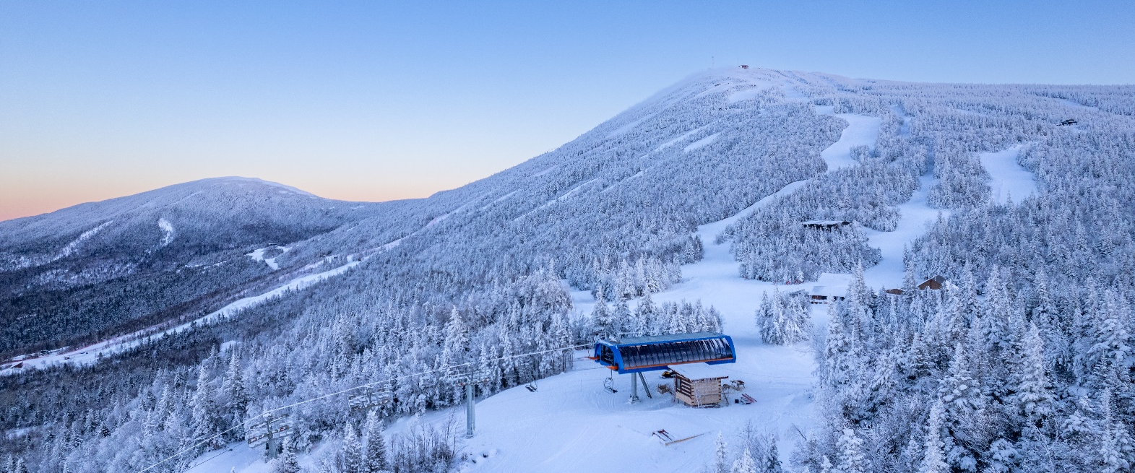
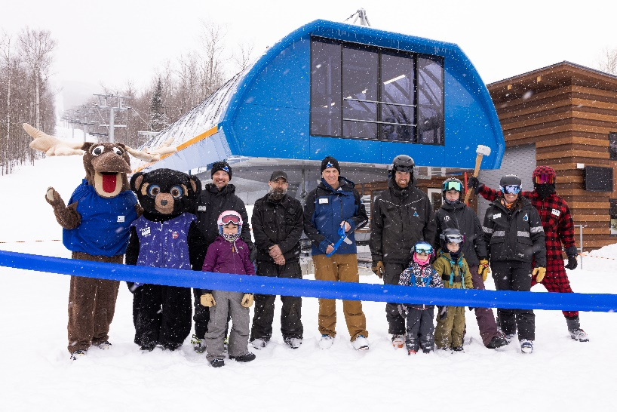
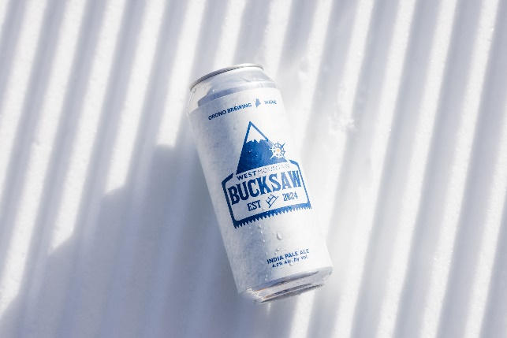
Resort Highlights & Projects
West Mountain – Phase 1
Largest single-year terrain expansion in the Northeast since the late 1970's​
Majority of work completed by Sugarloaf Team​
12 new ski trails spanning 120 skiable acres​ offering incredible (new) views of Crocker Mountains.
Installation of highspeed quad:
Bucksaw Express​ increasing uphill lift capacity by 14%
Inspired new collaboration with Orono Brewing: Bucksaw Beer

Slide 44
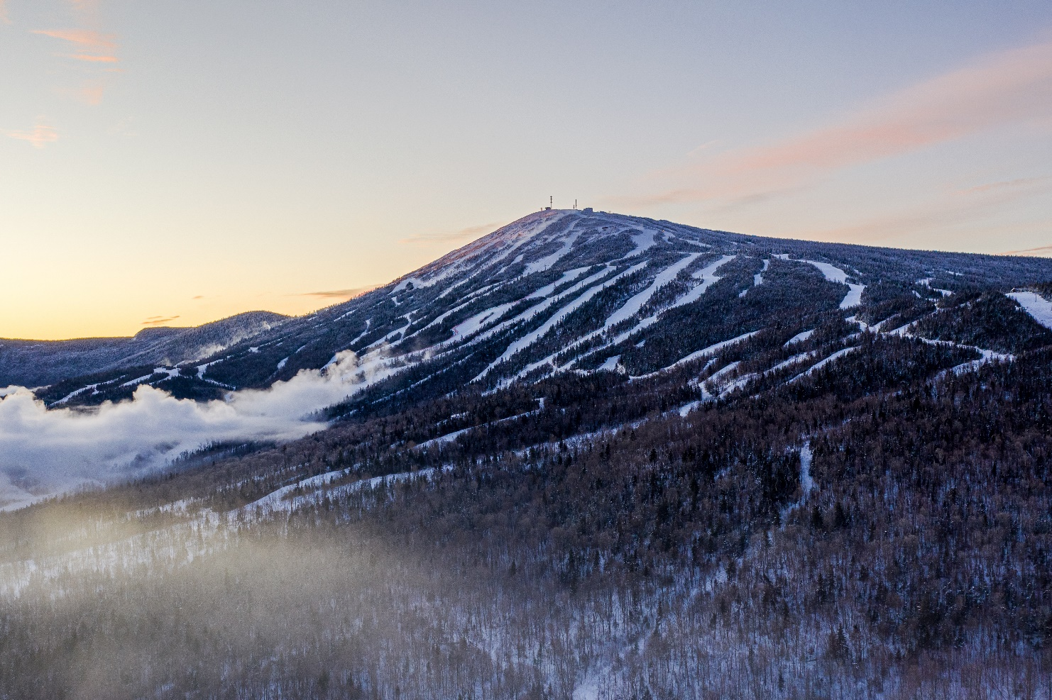
Resort Highlights & Projects
Snowmaking Upgrades & Efficiencies
75,000 feet of snowmaking pipe and 230+ HKD snowmaking guns installed as part of West Mountain Expansion.
Increased total snowmaking acreage by 69 acres (22.5%) heading into 23/24 winter season. From 307 – 376 acres of snowmaking coverage.
Achieved 100% Low Energy snowmaking – HUGE win. Only other major resort on the East Coast to achieve this is Mount. Snow.

Slide 45
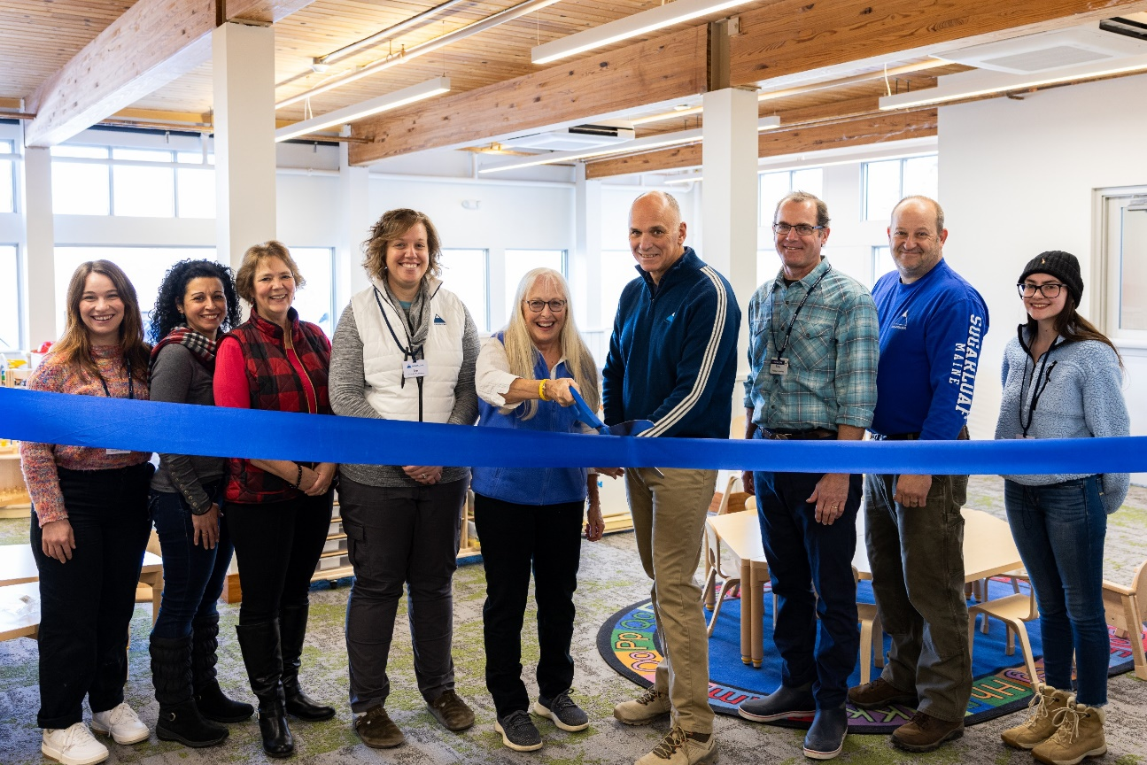
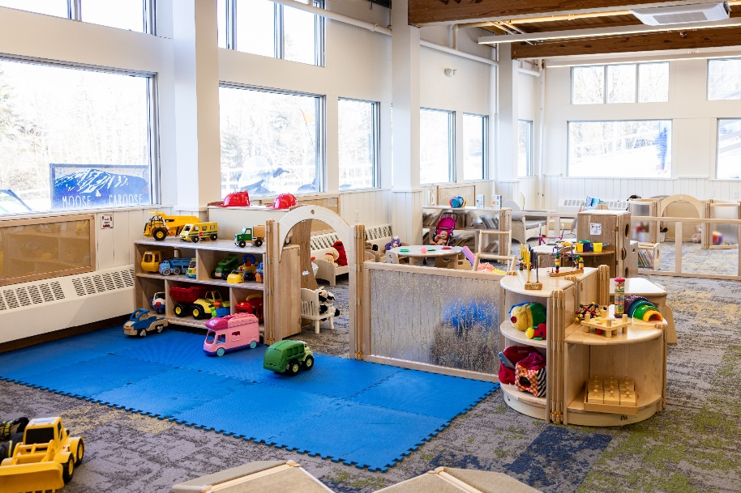
Resort Highlights & Projects
Marcia White Children’s Center
Year round facility doubling capacity for children ages 18 months to 3 years old
​
New revenue opportunity​
Excellent benefit / service for guests while creating opportunities for young families to fall in love with Sugarloaf!

Slide 46
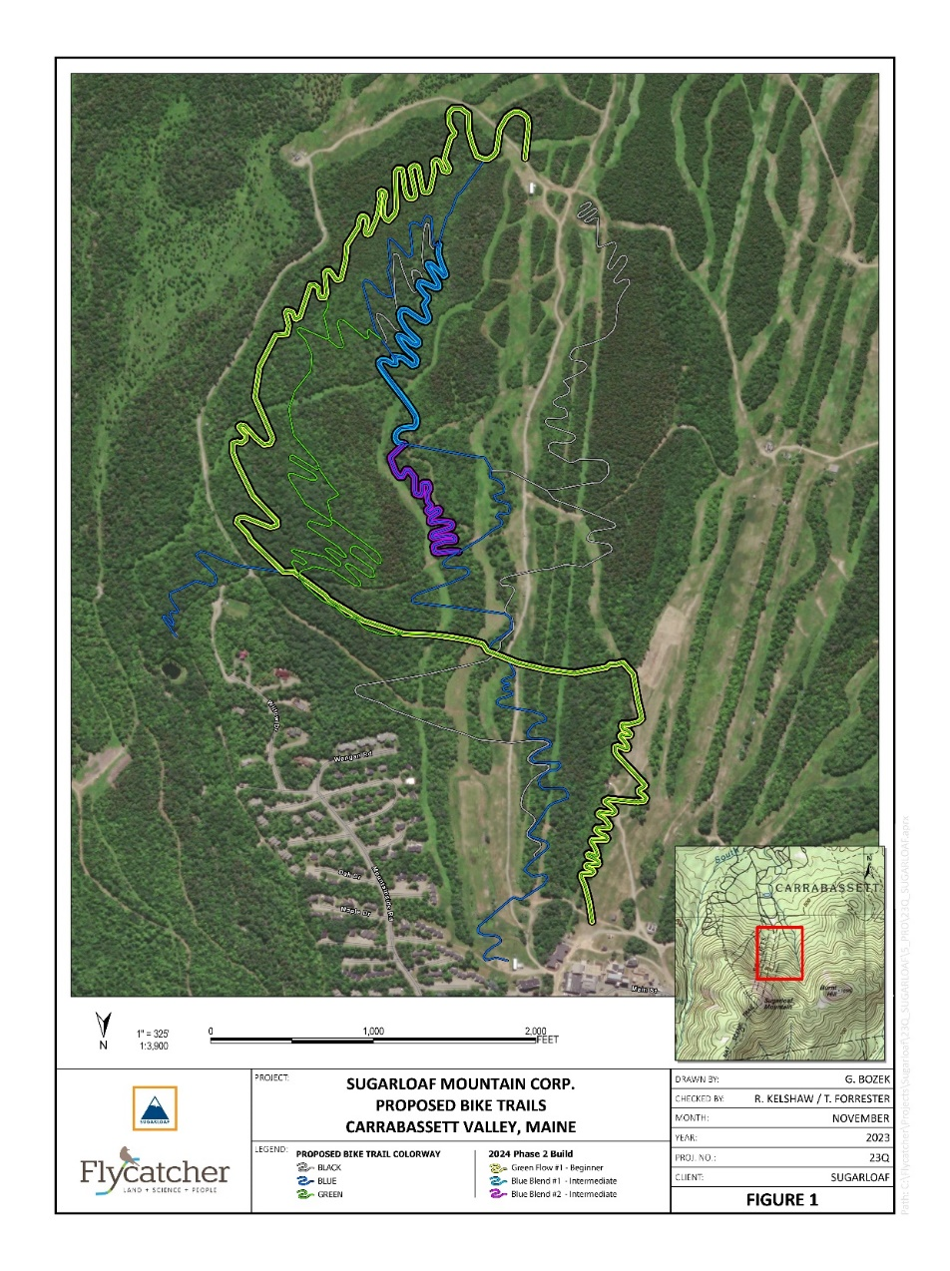
Resort Highlights & Projects
Sugarloaf Bike Park – Phase 1
Completed DEP permits and engineering for trail development​.
Begin construction of Family-friendly trails. ​
Soft opening of bike park in Fall creating awareness for Summer 2025 launch​.
New Sugarloaf-run bike rental, retail and service center located in the Outdoor Center

Slide 47

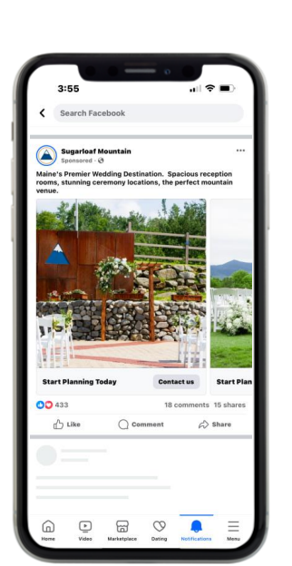
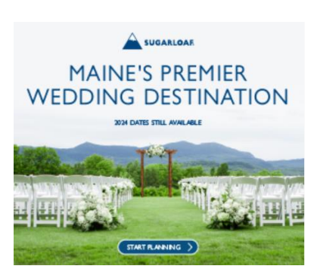

Sales & Marketing Highlights
Collaboration like never before
Dedicated paid advertising for weddings
Highest # of booked weddings post COVID spike.
Identified new window of opportunity for winter weddings (early November – mid-December)
$19k investment resulted in:
  82 Wedding Conversion leads
  13k clicks to site

Slide 48




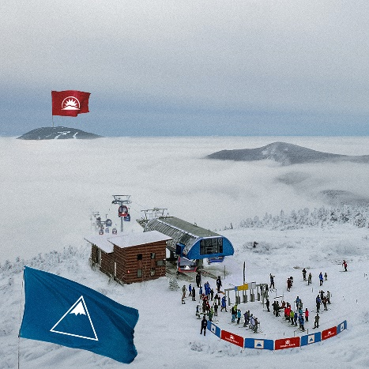
Marketing Highlights
Milestone after Milestone
Record-breaking skier visits; rollout of new Sugarloaf specific ticket pack
Record-breaking Ikon visits
(and runner-up in the Ikon Pass Bark Bracket with our furriest member of the IT Team)
Highest Net Promoter Score in the Boyne Resort Family and ever at Sugarloaf.
Viral social media efforts.
Ongoing successful implementation of Sugarloaf App and on campus digital displays.
70.0
Net Promoter Score
A customer experience metric that measures how likely they are to recommend
Boyne Resorts company avg 52.7

Slide 49
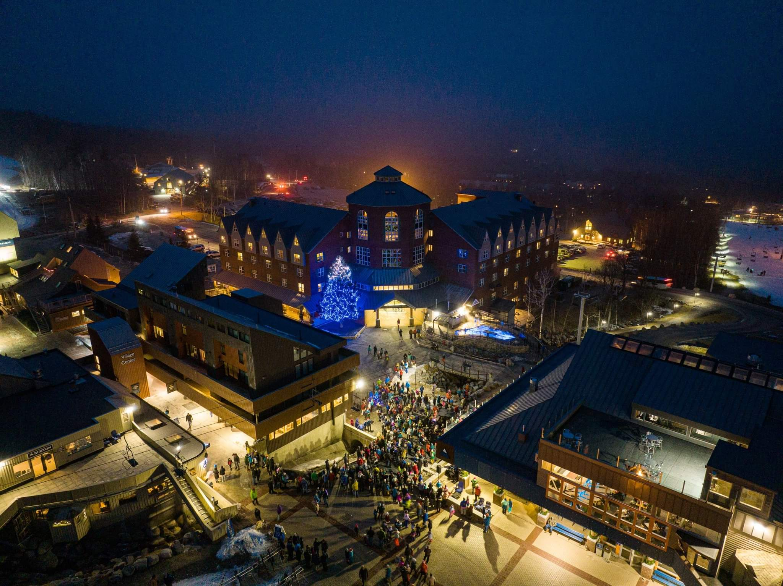

Thank you.
Q & A
Followed by our annual social
Hosted by:

